Slide 1
Model Interpretability
Ben Auerbach
With many, many slides from Been Kim’s original talk: Interpretability beyond feature attribution quantitative testing with concept activation vectors

Slide 2
What is a model?

Slide 3
What is a model?
A mathematical description of how concepts relate to a concept of interest

Slide 4
What makes a good model?

Slide 5
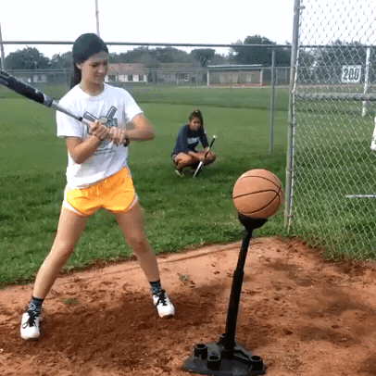
What makes a good model?
You can predict the behavior of the system of interest subject to a change in the model parameters or inputs

Slide 6
What makes a good model?
You can predict the behavior of the system of interest subject to a change in the model parameters or inputs
The most important parameters of the model are human interpretable concepts

Slide 7
My neural net shows high performance on my validation set…why do I care about interpretability?

Slide 8
My neural net shows high performance on my validation set…why do I care about interpretability?
Reason 1: When working with correlated feature inputs, your model may be biased

Slide 9

My neural net shows high performance on my validation set…why do I care about interpretability?
Reason 1: When working with correlated feature inputs, your model may be biased

Slide 10
My neural net shows high performance on my validation set…why do I care about interpretability?
Reason 1: When working with correlated feature inputs, your model may be biased
Reason 2: You may want to do inference

Slide 11
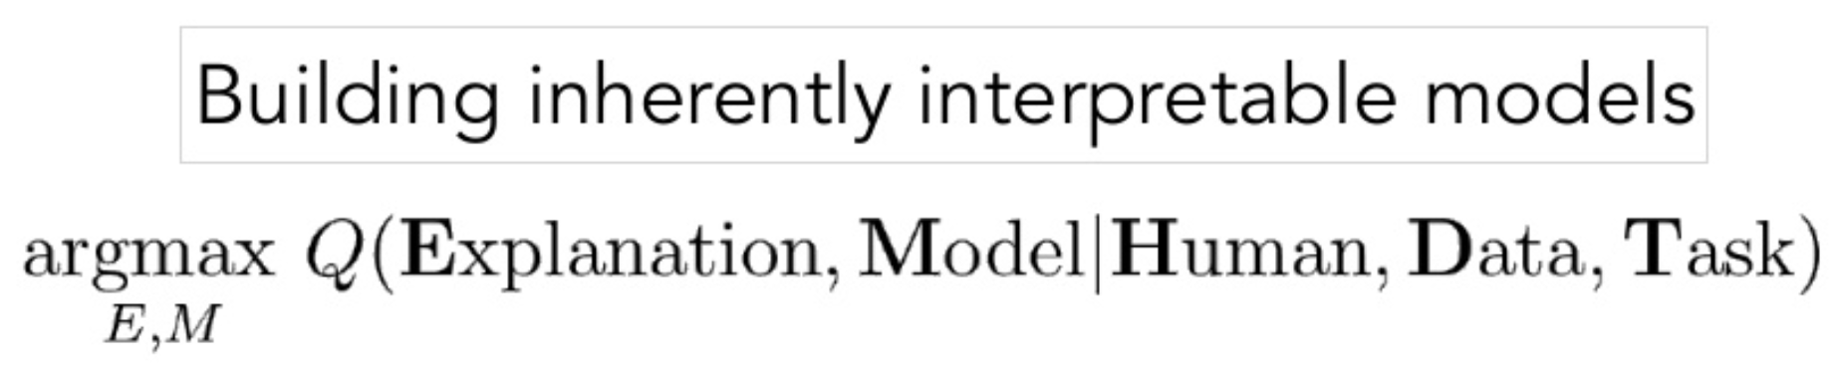
Approaches toward model interpretability
Option 1: use domain knowledge to construct model

Slide 12
Approaches toward model interpretability
Option 1: use domain knowledge to construct model
Limitations:
Sometimes adequate domain knowledge is only weakly present

Slide 13
Approaches toward model interpretability
Option 1: use domain knowledge to construct model
Limitations:
Sometimes adequate domain knowledge is only weakly present
Representing data using domain knowledge may explode the size of the parameter space

Slide 14
Approaches toward model interpretability
Option 1: use domain knowledge to construct model
Limitations:
Sometimes adequate domain knowledge is only weakly present
Representing data using domain knowledge may explode the size of the parameter space
E.g. full model describing cellular behavior has on the order of billions of parameters

Slide 15
Approaches toward model interpretability
Option 1: use domain knowledge to construct model
Limitations:
Sometimes adequate domain knowledge is only weakly present
Representing data using domain knowledge may explode the size of the parameter space
…and it’s pretty time consuming

Slide 16
Approaches toward model interpretability
Option 1: use domain knowledge to construct model
Limitations:
Sometimes adequate domain knowledge is only weakly present
Representing data using domain knowledge may explode the size of the parameter space
…and it’s pretty time consuming
Option 2: come up with a post-hoc analysis

Slide 17
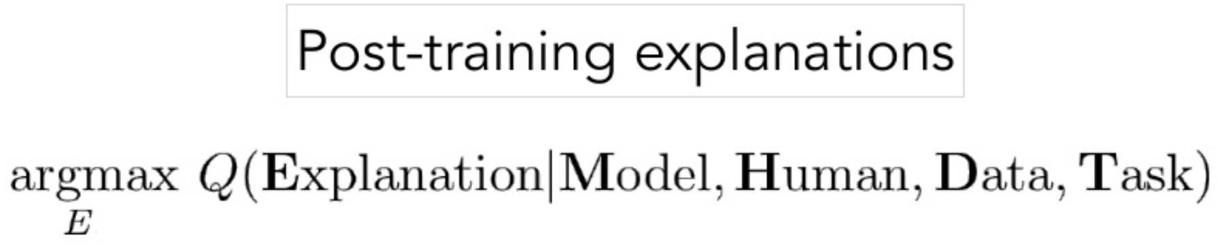
Approaches toward model interpretability
Option 1: use domain knowledge to construct model
Limitations:
Sometimes adequate domain knowledge is only weakly present
Representing data using domain knowledge may explode the size of the parameter space
…and it’s pretty time consuming
Option 2: come up with a post-hoc analysis

Slide 18
Saliency Maps
For a fixed model with parameters theta and fixed input vector X, find the features that alter the output most

Slide 19
Saliency Maps
For a fixed model with parameters theta and fixed input vector X, find the features that alter the output most
I.e. the most important features

Slide 20
Saliency Maps
For a fixed model with parameters theta and fixed input vector X, find the features that alter the output most
I.e. the most important features
Compute for each x_i at fixed X:

Slide 21
In the case of image data, we can visualize the most important features used by the model

Slide 22
Problem 1: These saliency maps are not always interpretable themselves
A “cash machine”

Slide 23
Problem 2: When we think they’re easily interpretable…they might not be

Slide 24
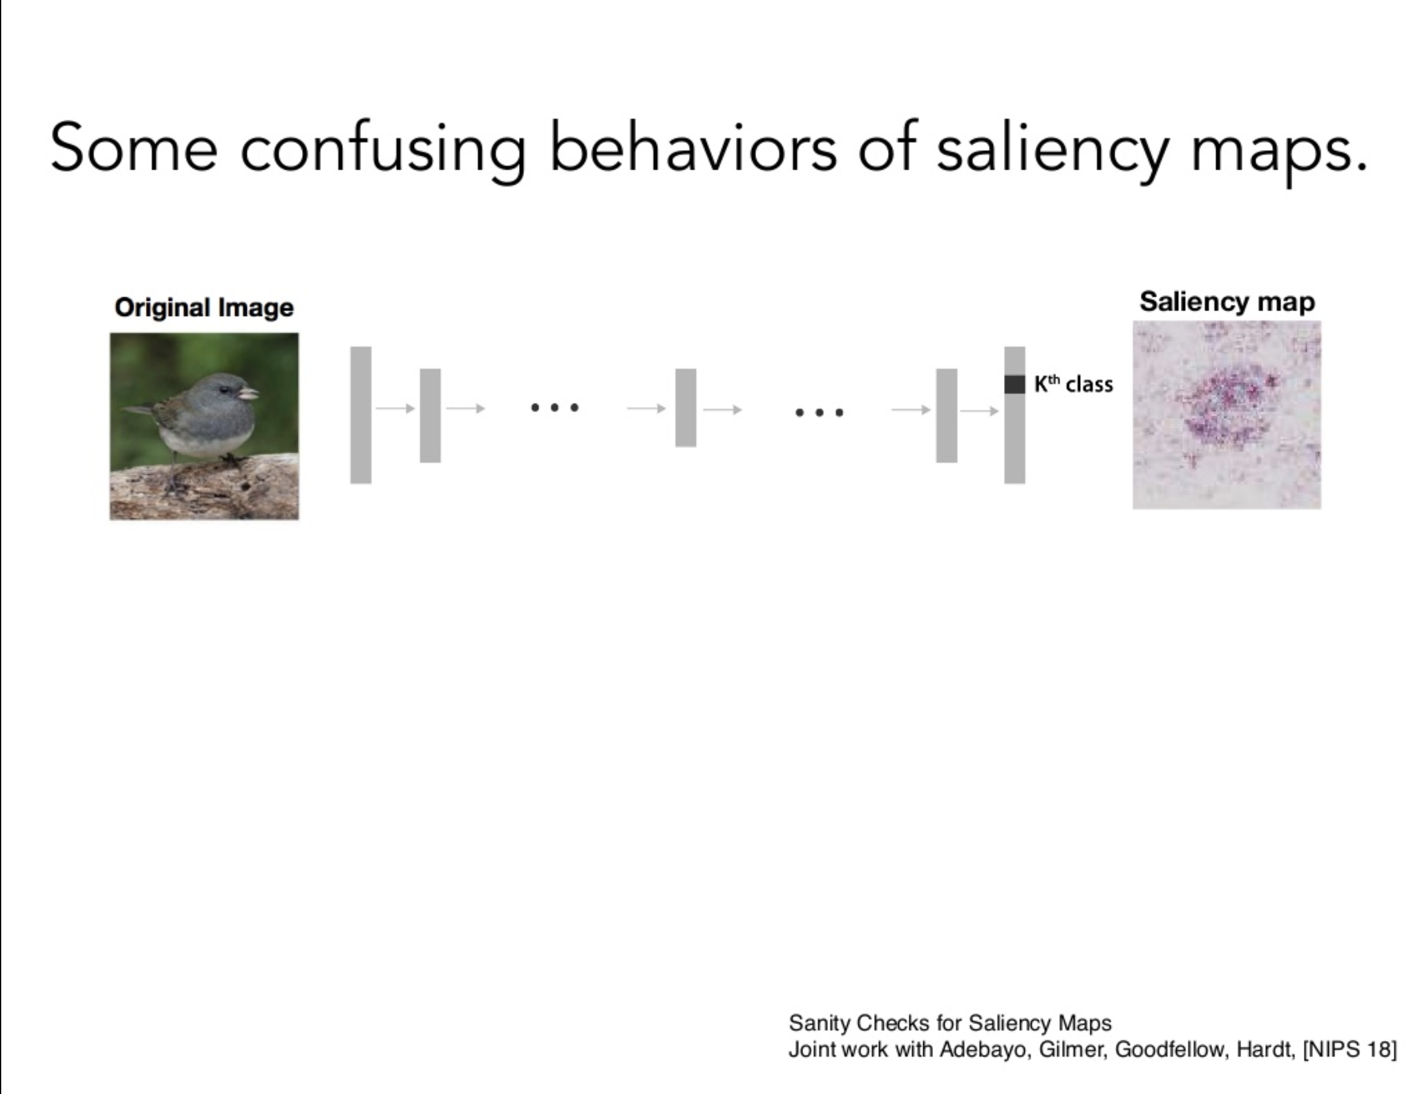

Slide 25
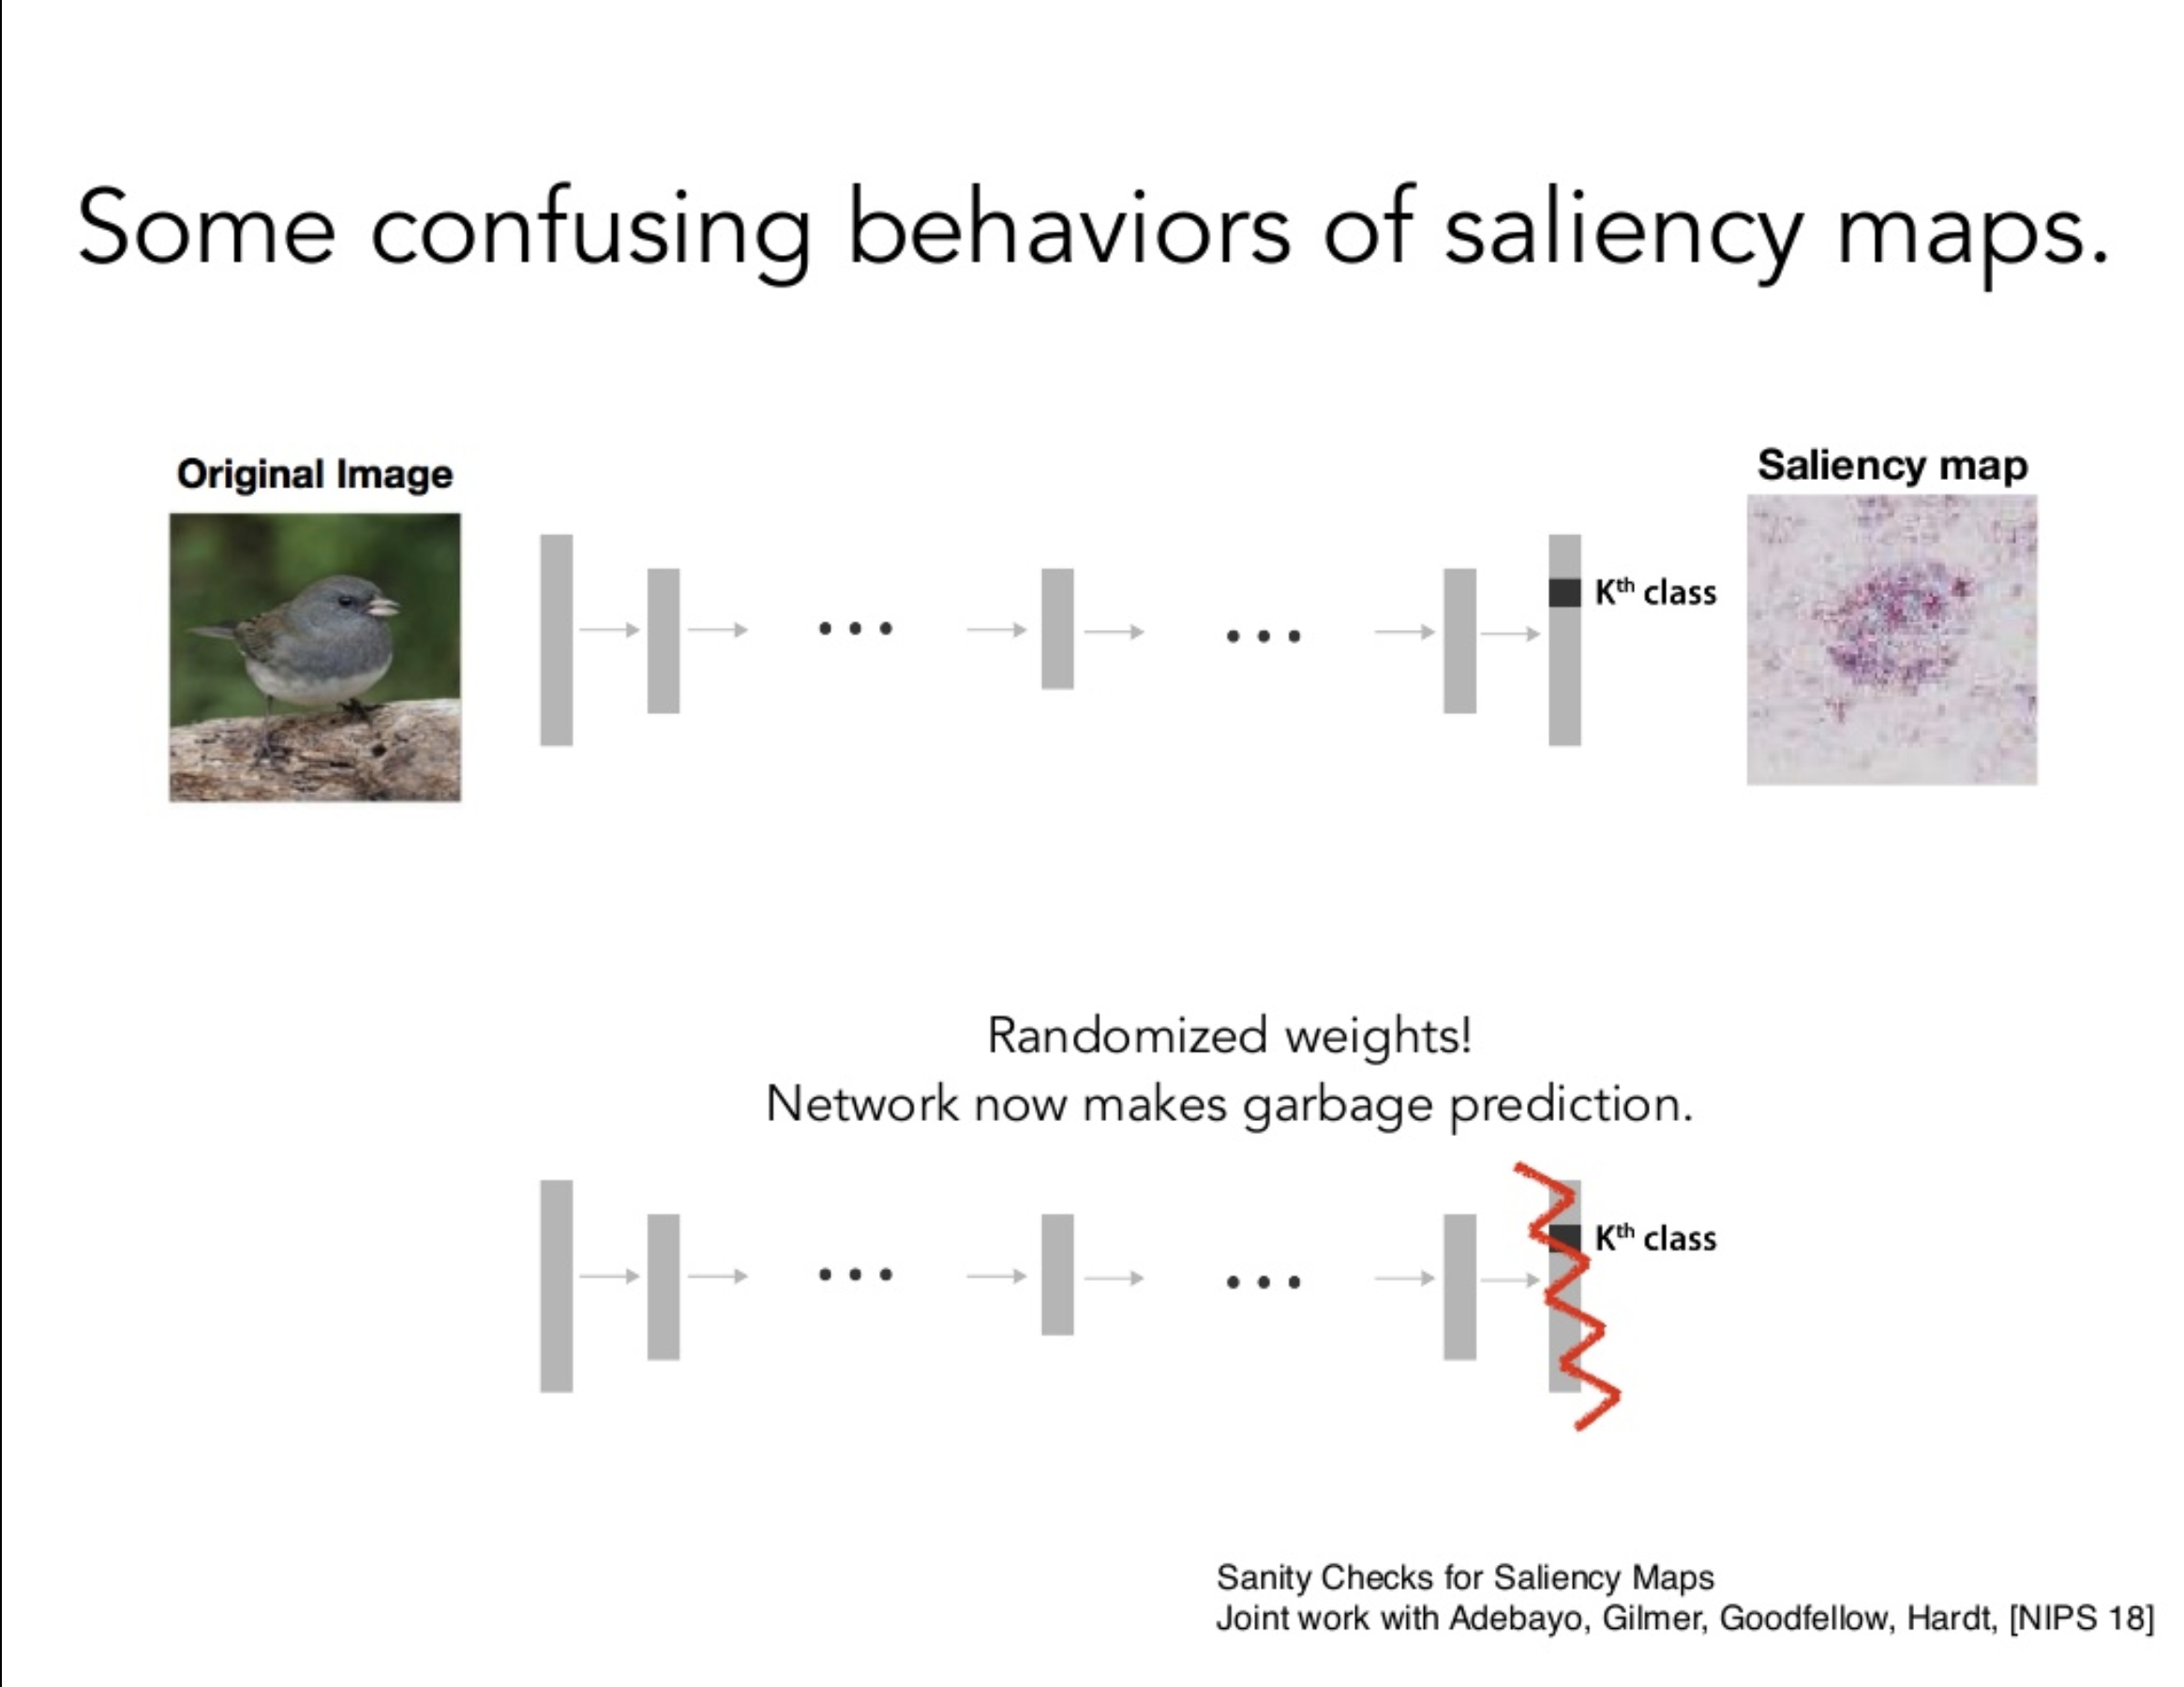

Slide 26
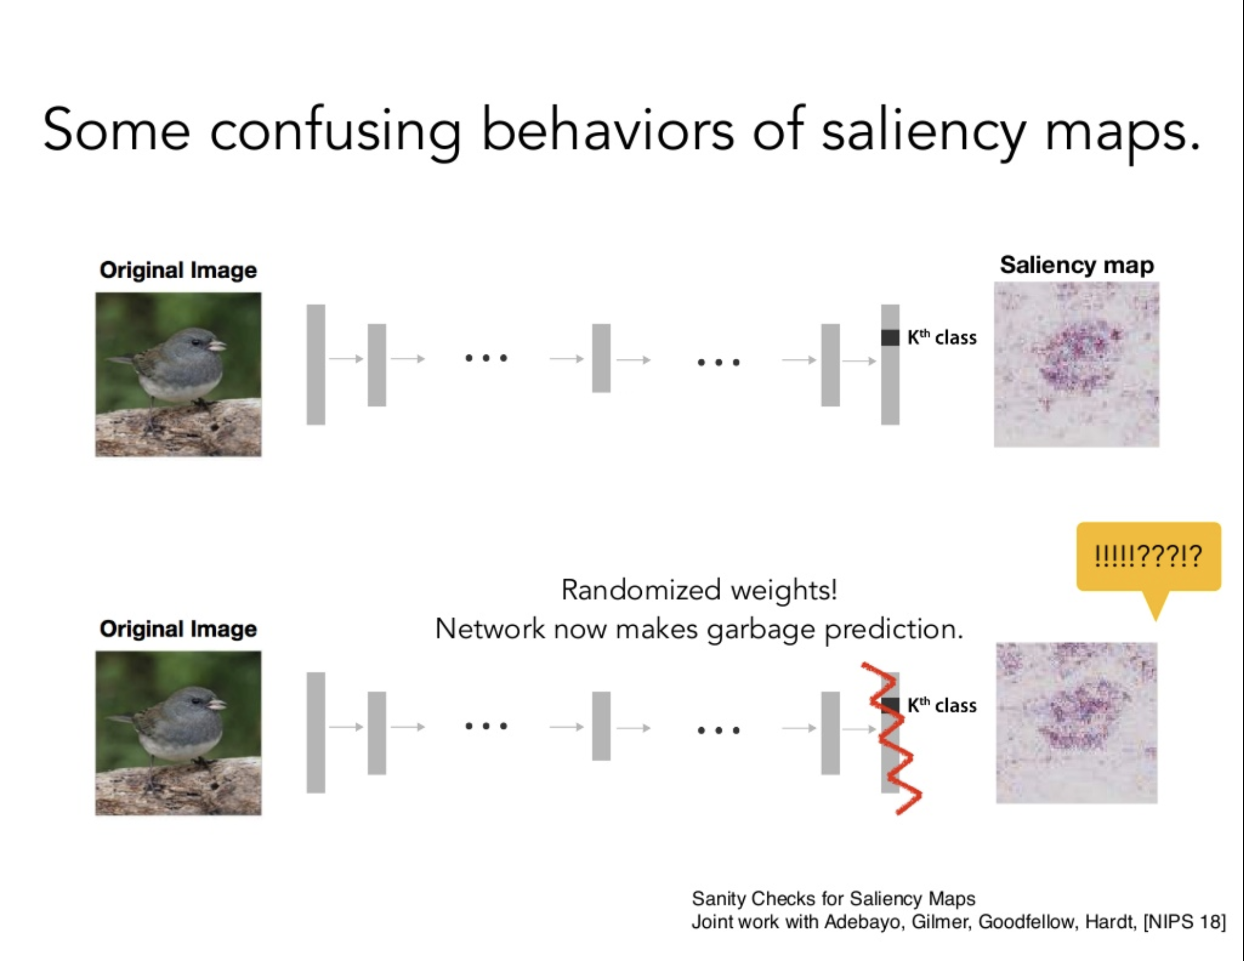

Slide 27
Problem 3: Not easy to make conceptual generalizations from a distribution of examples
More specifically, no obvious mapping from the saliency map space to the model space for a given concept
Saliency map outputs are training example specific

Slide 28
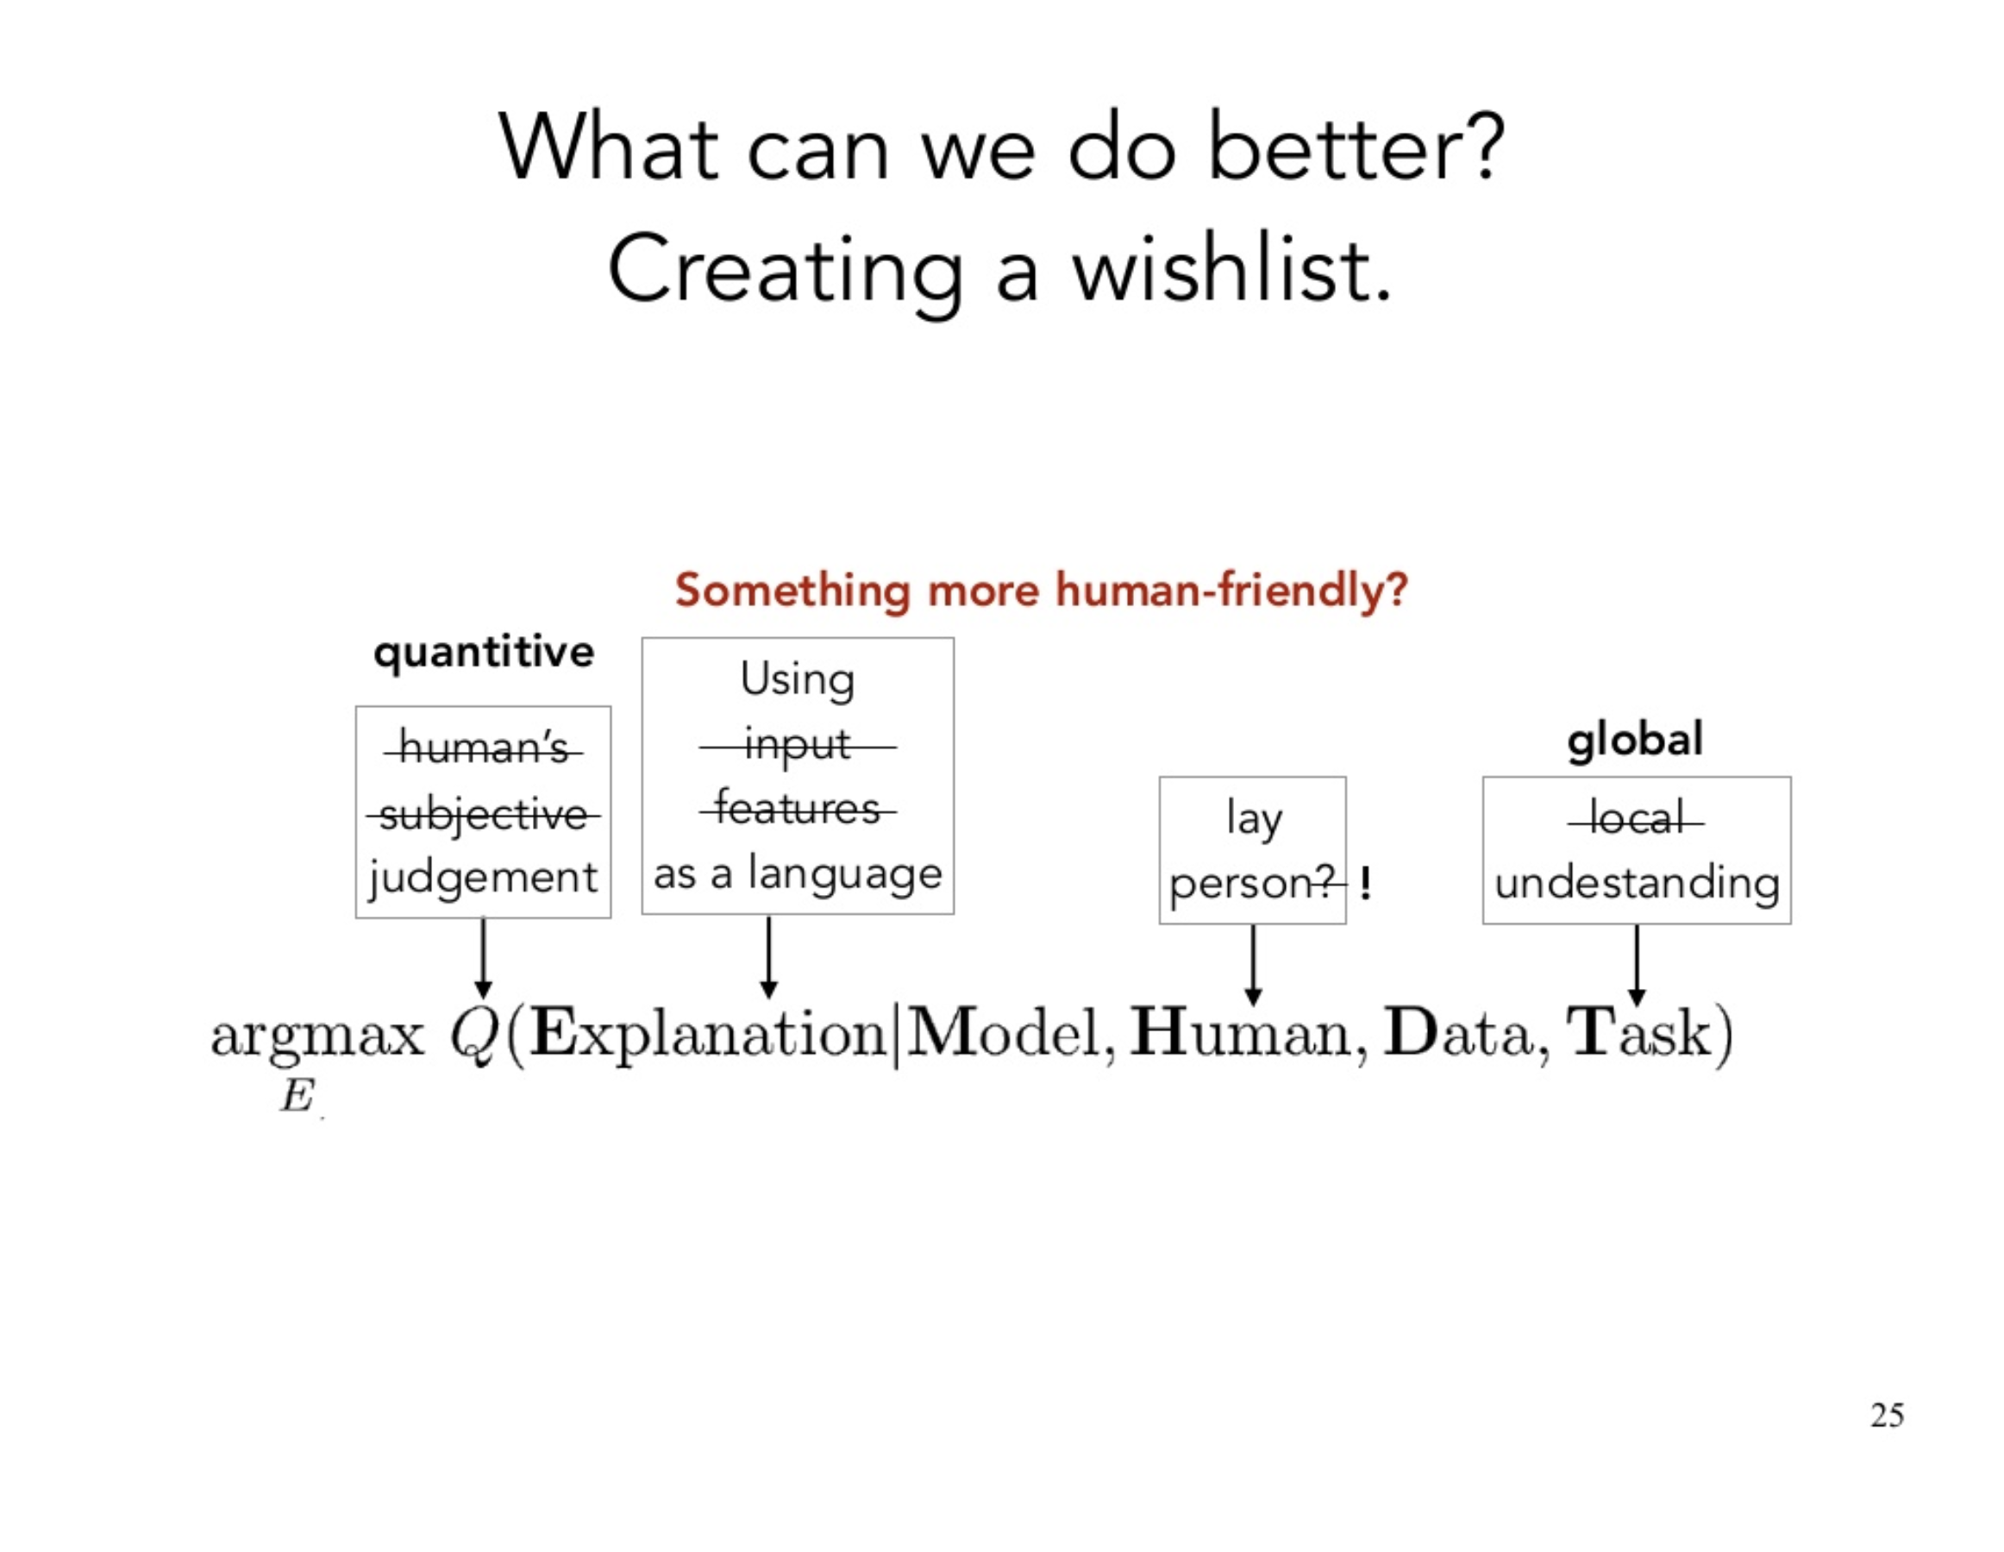

Slide 29
Testing with Concept Activated Vectors (TCAV)

Slide 30
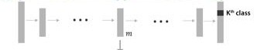

Goal of TCAV:
Testing with Concept Activation Vectors
Quantitative explanation: how much a concept (e.g., gender, race) was important for a prediction in a trained model.
…even if the concept was not part of the training.
42
ICML 2018

Slide 31
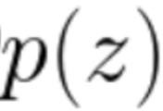

Goal of TCAV:
Testing with Concept Activation Vectors
A trained machine learning model
(e.g., neural network)
zebra-ness
Was
striped concept
important
to this
zebra image classifier?

Slide 32




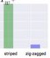
Goal of TCAV:
Testing with Concept Activation Vectors
A trained machine learning model
(e.g., neural network)
zebra-ness
TCAV provides
Was
striped concept
important
TCAV score for
Zebra
quantitative importance of
to this
zebra image classifier?
a concept if and only if your network learned about it.
striped
not striped

Slide 33





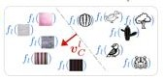
TCAV:
Testing with Concept Activation Vectors
A trained machine learning model
(e.g., neural network)
zebra-ness
Was
striped concept
important
to this zebra image classifier?
TCAV
Learning CAVs
How to define
concepts?

Slide 34

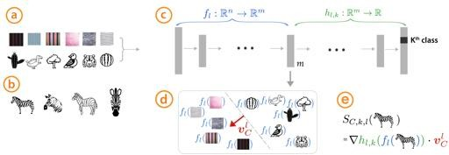


Defining concept activation vector (CAV)
Inputs:
Examples of
c
oncepts
Random
images
A trained network under investigation
and Internal tensors

Slide 35
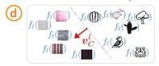



Defining concept activation vector (CAV)
Inputs:
Train a linear classifier to separate activations.
CAV ( ) is the vector
orthogonal to the decision boundary.
[Smilkov ’17, Bolukbasi ’16 , Schmidt ’15]

Slide 36

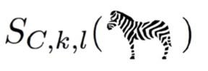
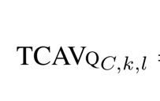
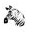

TCAV:
Testing with Concept Activation Vectors
A trained machine learning model
(e.g., neural network)
zebra-ness
Was
striped concept
important
to this
zebra image classifier?
TCAV
1. Learning CAVs
2. Getting TCAV score
2. How are the CAVs useful to get explanations?

Slide 37
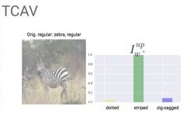
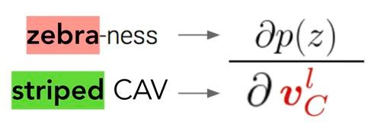
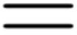
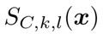
TCAV core idea:
Derivative with CAV to get prediction sensitivity
TCAV score
Directional derivative with CAV

Slide 38
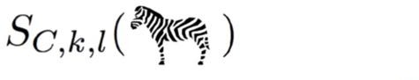
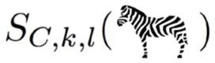
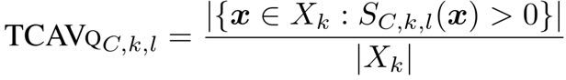
TCAV core idea:
Derivative with CAV to get prediction sensitivity
TCAV score
striped CAV
Directional derivative with CAV

Slide 39
TCAV:
Testing with Concept Activation Vectors
A trained machine learning model
(e.g., neural network)
zebra-ness
Was
striped concept
important
to this
zebra image classifier?
TCAV
1. Learning CAVs
2. Getting TCAV score

Slide 40

TCAV:
Testing with Concept Activation Vectors
A trained machine learning model
(e.g., neural network)
zebra-ness
Was
striped concept
important
to this
zebra image classifier?
TCAV
1. Learning CAVs
2. Getting TCAV score
3. CAV validation
Qualitative Quantitative

Slide 41
Guarding against spurious CAV
Quantitative validation:
Did my CAVs returned high sensitivity by chance?

Slide 42
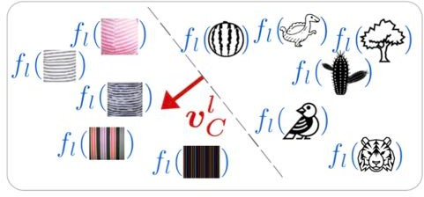
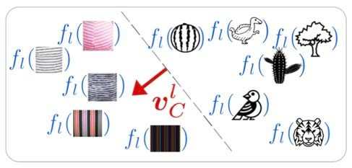



Quantitative validation:
Guarding against spurious CAV
Learn many stripes CAVs using different sets of random images

Slide 43
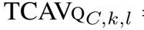
Quantitative validation:
Guarding against spurious CAV
Zebra
…
…

Slide 44
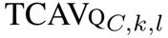
Quantitative validation:
Guarding against spurious CAV
Zebra
…
…

Slide 45

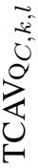


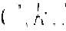
Quantitative validation:
Guarding against spurious CAV
Zebra
TCAV score random
…
*
Check the distribution of
is statistically different from random
using t-test
…

Slide 46
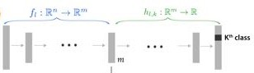
How to choose a layer
Start from the top layer (closest to prediction).
Go down a layer if the current layer doesn’t pass the statistical testing.

Slide 47

Recap TCAV:
Testing with Concept Activation Vectors
Even if your training data wasn’t
TCAV provides quantitative importance of a concept if and only if your
network learned about it.
tagged with the concept
Even if your input feature did
not include the concept
1. Learning CAVs
2. Getting TCAV score
3. CAV validation
Qualitative Quantitative

Slide 48
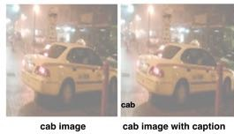
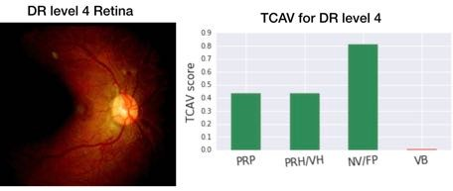
Results
Sanity check experiment
Biases in Inception V3 and GoogleNet
Domain expert confirmation from Diabetic Retinopathy

Slide 49
Results
1. Sanity check experiment
Biases from Inception V3 and GoogleNet
Domain expert confirmation from Diabetic Retinopathy

Slide 50

Sanity check experiment
If we know the ground truth (important concepts),
will TCAV match?

Slide 51
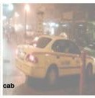
Sanity check experiment setup
An image
+
Potentially noisy Caption

Slide 52

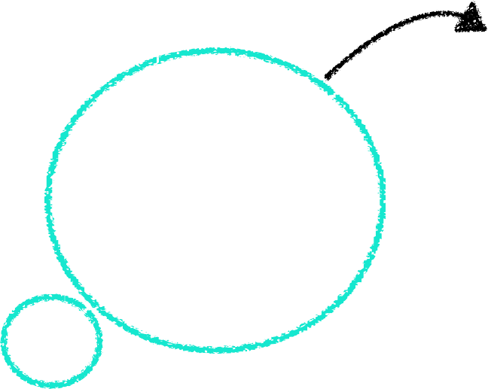

Sanity check experiment setup
models can use either
image
image or caption
concept
concept for classification.
caption concept
An image
+
Potentially noisy Caption

Slide 53

Sanity check experiment setup
models can use either
image
image or caption
concept
concept for classification.
caption concept
An image
+
Potentially noisy Caption
Four models trained with
different caption noise levels

Slide 54
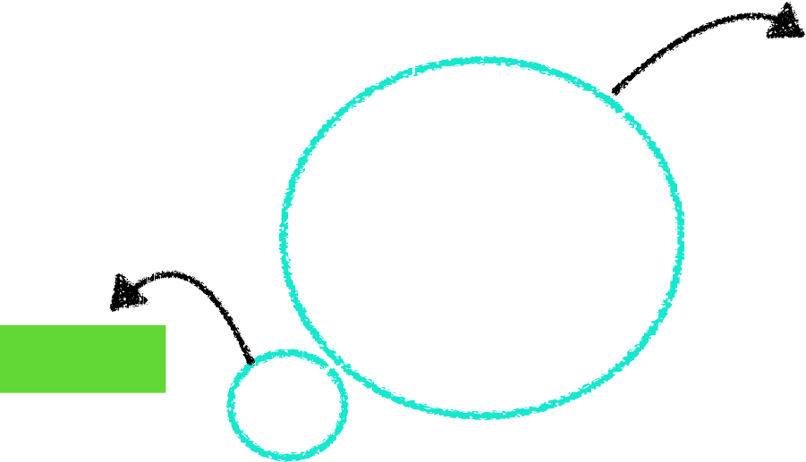
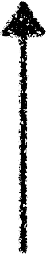

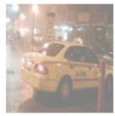



Sanity check experiment setup
models can use either
image
image or caption
concept
concept for classification.
caption concept
Test models with no caption image.
Test accuracy
=
Importance of
image concept
Four models trained with
different caption noise levels

Slide 55
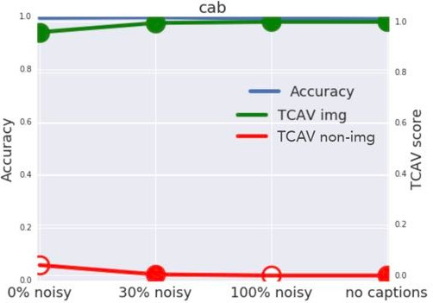
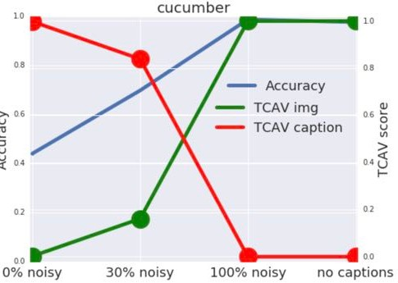

Sanity check experiment
Test accuracy with
no caption image
Caption noise level in training set
Caption noise level in training set

Slide 56

Sanity check experiment
Test accuracy with
no caption image
Caption noise level in training set
Caption noise level in training set
Cab class never cared about the caption!

Slide 57
Cool, cool.
Can saliency maps do this too?

Slide 58
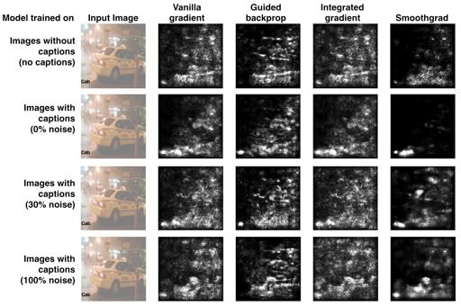
Can saliency maps communicate the same information?
Image
Ground truth
with caption
Image concept
Image concept
Image concept
Image concept
70

Slide 59
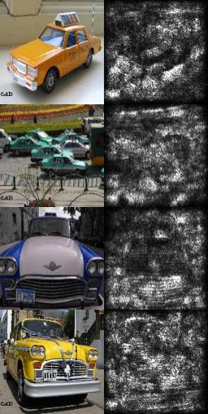
Human subject experiment:
Can saliency maps communicate the same information?
50 turkers are
asked to judge importance of image vs. caption given saliency maps.
asked to indicate their confidence
shown 3 classes (cab, zebra, cucumber) x 2 saliency maps for one model
image
c. ept

Slide 60
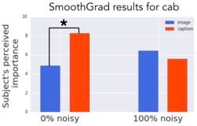
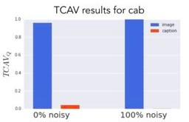
Human subject experiment:
Can saliency maps communicate the same information?
Random chance: 50%
Human performance with saliency map: 52%
Humans can’t agree: more than 50% no significant consensus
• Humans are very confident even when they are wrong.

Slide 61
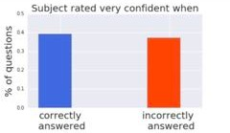
Human subject experiment:
Can saliency maps communicate the same information?
Random chance: 50%
Human performance with saliency map: 52%
Humans can’t agree: more than 50% no significant consensus
Humans are very confident even when they are wrong.

Slide 62
Results
1. Sanity check experiment
Biases from Inception V3 and GoogleNet
Domain expert confirmation from Diabetic Retinopathy

Slide 63
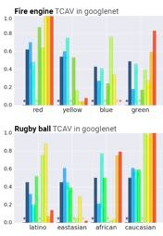
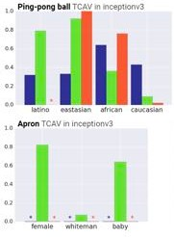
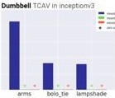
TCAV in
Two widely used image prediction models

Slide 64

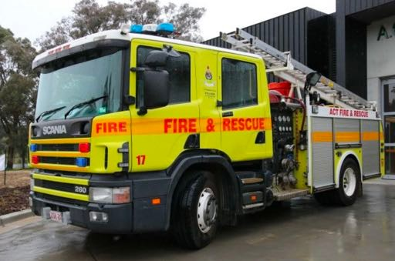
TCAV in
Two widely used image prediction models
Geographical bias!
7
6
http://www.abc.net.au

Slide 65

TCAV in
Two widely used image prediction models
Geographical bias?
Quantitative confirmation to previously qualitative findings
[Stock & Cisse, 2017]
77

Slide 66
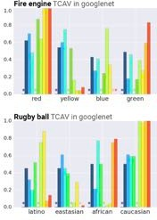
TCAV in
Two widely used image prediction models
Geographical bias?
Quantitative confirmation to previously qualitative findings
[Stock & Cisse, 2017]
78
Goal of interpretability:
To use machine learning responsibly
we need to ensure that
our values are aligned
our knowledge is reflected

Slide 67
Results
Sanity check experiment
Biases Inception V3 and GoogleNet
Domain expert confirmation from Diabetic Retinopathy

Slide 68
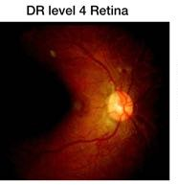
Diabetic Retinopathy
Treatable but sight-threatening conditions
Have model to with accurate prediction of DR (85%) [Krause et al., 2017]
Concepts
the ML model uses
Vs
Diagnostic
Concepts
human doctors use

Slide 69



Collect human doctor’s knowledge
 | Concepts belong to this level | Concepts do not belong to this level
DR level 4 | PRP PRH/VH NV/FP | VB
DR level 1 | MA | HMA

Slide 70

TCAV for Diabetic Retinopathy
Prediction Prediction class accuracy
Example
TCAV scores
TCAV shows the model is consistent with doctor’s knowledge when model is accurate
DR level 4
High
PRP PRH/VH
NV/FP VB
Green: domain expert’s label on concepts belong to the level
Red: domain expert’s label on concepts does not belong to the level

Slide 71



TCAV for Diabetic Retinopathy
Prediction Prediction class accuracy
Example
TCAV scores
TCAV shows the model is consistent with doctor’s knowledge when model is accurate
DR level 4
High
PRP PRH/VH
NV/FP VB
TCAV shows the model is inconsistent with doctor’s knowledge for classes when model is less accurate
DR level 1
Med
MA
HMA
Green: domain expert’s label on concepts belong to the level
Red: domain expert’s label on concepts does not belong to the level

Slide 72


TCAV for Diabetic Retinopathy
Prediction Prediction _{Example} Level 1 was often confused to level 2.
class accuracy TCAV scores _{hows the}
consistent
octor’s
DR level 4 High dge when
s accurate
PRP P
TCAV shows the model is inconsistent
_{DR level 1 Low} with doctor’s
knowledge for classes when model is less accurate
MA HMA
Green: domain expert’s label on concepts belong to the level
Red: domain expert’s label on concepts does not belong to the level
84
TCAV s
model is
with d knowle model i
RH/VH NV/FP VB
Goal of interpretability:
To use machine learning responsibly
we need to ensure that
our values are aligned
our knowledge is reflected

Slide 73

Summary:
github.com/tensorflow/tcav
Testing with Concept Activation Vectors
Joint work with Wattenberg, Gilmer, Cai, Wexler, Viegas, Sayres
TCAV provides quantitative importance of a concept if and only if your
network learned about it.
stripes concept (score: 0.9)
was important to zebra class
for this trained network.
PRP PRH/VH
NV/FP VB
Our values
Our knowledge
85
ICML 2018

Slide 74


Limitations of TCAV
Concept has to ‘expressible’ using examples (e.g., “love” concept might be hard).
User needs to know which concepts they want to test, and have examples for it. Follow-up work to automatically discover concepts for images (submitted), but many more directions are possible.
Explanations provided by TCAV are not-causal
- Follow-up work on causal TCAV (submitted)
89

